Slide 1

SAFE SPORT OVERVIEW
For Staff & Volunteers

Slide 2
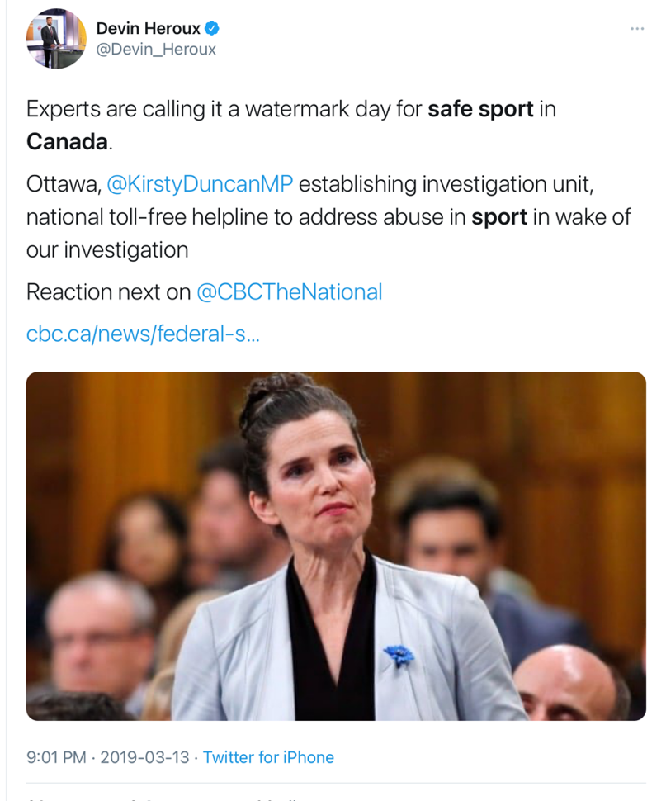
WHAT IS SAFE SPORT
Creating a healthy, positive, safe, training and competitive sport environment that by its cultural nature is free of maltreatment and abuse
Culture
A culture is the expression of sport’s values, attitudes, and beliefs about sport.
It determines if focus is on fun & mastery or winning, team success or individual success

Slide 3
PURPOSE OF SAFE SPORT POLICIES
To create
consistent expectations
and implement a nationally aligned support system to respond to situations

Slide 4
UCCMS
Universal Code of Conduct to Prevent and Address Maltreatment in Sport
Created by athletes for athletes
Addresses the most serious breaches
Separates maltreatment from misconduct
Read at link provided, may be updated at various times

Slide 5
Sport organizations that have adopted the present UCCMS are committed to creating a sport environment that is
free from all forms of Maltreatment and that treats all Participants with dignity and respect.

Slide 6
Key Definitions
Maltreatment
Any volitional act by an individual that results in harm or the potential for physical or psychological harm to another Individual,
Psychological verbal – personal criticism, body shaming,
Non assaultive physical – throwing things or punching objects
Denying Attention – abandonment as punishment, denying feedback or training opportunities
Physical - Contact or
Non Contact – forcing isolation, providing alcohol to minor, painful stance for no purpose, denying food, drink, medical attention, allowing early return from injury
Sexual
What does that look like in Sailing

Slide 7
Key Definitions
Neglect
Any pattern, or a single serious incident, of lack of reasonable care, inattention to an Individual’s needs, nurturing or well-being, or omissions in care.
Neglect is determined by the objective behaviour but the behaviour must be evaluated with consideration given to the Individual’s needs and requirements, not whether harm is intended or results from the behaviour.
What does that look like
Not providing recovery time from injury
Not considering disabilities
Not providing supervision of athletes
Not considering welfare of athlete in training
Failure to ensure safety
Allowing them to disregard rules, regulations

Slide 8
Grooming & Gatekeepers
Slow gradual & escalating process of building comfort and trust with an athlete and/or their parents/guardian
Often very difficult to recognize
Allows for inappropriate conduct to become normalized
Often preceded by building confidence and comfort that an individual can be trusted with the care of the athlete.
What does that look like
Favouritism, extra time and attention, gifts
All appears innocent and well intentioned
Private communication – social media/text, personal photos
Private travel, meetings, time together

Slide 9
THE POLICY PACKAGE
PREVENTION
Codes of Conduct
Protection Policy
Social Media Policy
Screening Policy
Whistle Blower
RESPONSE
Discipline & Complaints Policy
Appeal Policy
Dispute Resolution Policy
DEFINITIONS
One set full package
RELATED
WORKPLACE
Harassment
Violence
PRIVACY

Slide 10
Code of Conduct
Provides the expectation of appropriate behaviour at all times for everyone and a commitment to follow all policies in place
Everyone
Maintain and enhance the dignity & self esteem of others
Refrain from maltreatment or prohibited behaviour
Abide by all laws and organizations policies
Respect property of others
In sailing activities, Adults not being under the influence, Minors not consuming alcohol etc.
Athlete Support Personnel
Provide necessary information
Ensure a safe environment
Recognize the power imbalance between you and an athlete, and act accordingly
Act in athlete’s best interest
Never condone use of drugs or prohibited substances
Sections for Board, Staff, Parents, Officials

Slide 11
PROTECTION POLICY
Provides what is an acceptable safe sport environment and associated safe sport actions between coaches and athletes
It sets guidelines on what is permitted in several situations:
Practices and Events
Communications
Virtual Settings
Travel
Locker Room/Changing Area
Photography/video
Physical Contact
Notes:
Athlete Protection Policy applies to coaches and athletes.

Slide 12
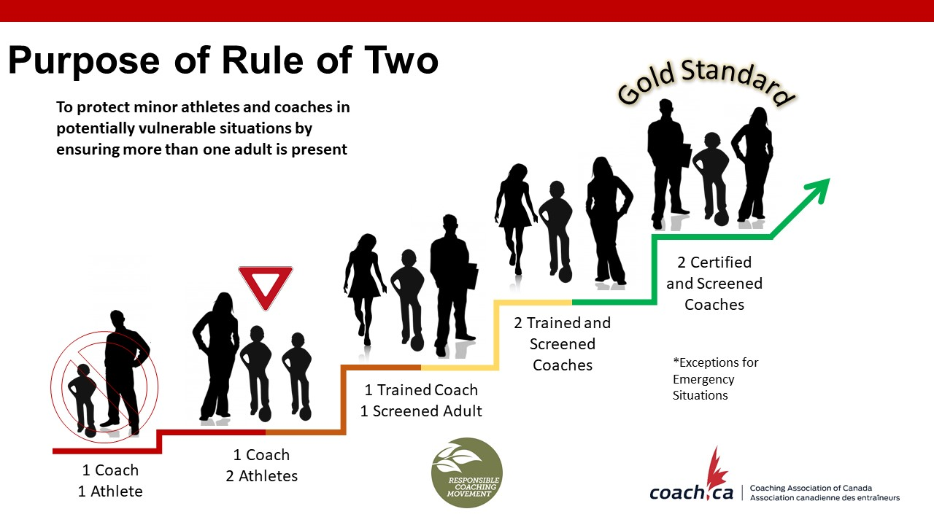
A Person in Authority should never be alone
with an Athlete

Slide 13
How do we make Rule of Two work?
Walk through a typical day – What situations may occur?
For example: Before & After Camp
Pickup and drop off should be timed with practice start and end times.
Participants wait in car, outside until multiple have arrived
What does Open & Observable look like?
For example: Participant meetings or 1 on 1 Coaching
Outside, visible and within earshot distance of another coach, screened volunteer, parent, or adult.

Slide 14
Education & Preparation
Communication with Participants & Parents
Know expectations, understand the “why”
Be proactive in ensuring everyone knows what’s acceptable.
Everyone has a role to play!

Slide 15


SOCIAL MEDIA & COMMUNICATIONS
ATHLETE-COACH COMMUNICATION
SOCIAL MEDIA
Remember, what you post represents you and sailing, forever!
No one-on-one communication – do not friend/follow etc.
Done through a method that can be recorded/documented i.e. Email, never to youth only
What is acceptable behaviour under the Code of Conduct and Protection Policy also applies to social media use

Slide 16
DISPUTE RESOLUTION POLICY
Facilitation and Mediation
Opportunities for Alternate Dispute Resolution (ADR) may be pursued at any point in a dispute when all Parties to the dispute agree that such a course of action would be mutually beneficial.
WHISTLE BLOWER POLICY
Encourages and Protects anyone who chooses to file a report.
No consequences or retaliation.
If you see something or experience something
PLEASE report it to the Independent Third Party

Slide 17
REPORTING - INDEPENDENCE IS KEY
At all levels, ensuring the process is independent from staff and Board is important
Reporting & Triaging
Easy to report concerns, 24/7 service
Work directly with a professional to determine next steps of your reported complaint.
ITP triages the complaint, and determines who will manage it
Individuals have fourteen (14) days to report a complaint to the ITP
Workplace Harassment Policy
As employees, this policy protects you from harassment. We are required to provide multiple people that you can report to, the ITP is one option in addition to directly reporting to supervisor, Board, other identified in policy

Slide 18


WHO’S WHO’S
Sport Dispute Resolution Centre Canada (SDRCC)
Abuse Free Sport
Independent program, operated by SDRCC
Provides a hub for resources and tools nationally
Operates the Canadian Sport Helpline
Office of Sport Integrity Commissioner (OSIC)
Independent program of SDRCC
Responsible to administer UCCMS
Pillar of Abuse Free Sport managing complaints
ITP – ITP SPORT
Sail Canada’s Identified Independent Third Party Reporting Mechanism

Slide 19
WHO ARE UCCMS PARTICIPANTS?
National Staff, Board, Committee Volunteers; National Team Athletes & Team Staff;
Any Athlete attending select National Activities and Events for the time frame they are at that event.
All Instructors/Coaches and Officials that are registered & in good standing
(Signed consent in your Sail Canada Profile/registration)
WHAT THIS MEANS
OSIC will manage any UCCMS related alleged breaches that involves a UCCMS Participant as the respondent to the complaint. Reported to OSIC!

Slide 20
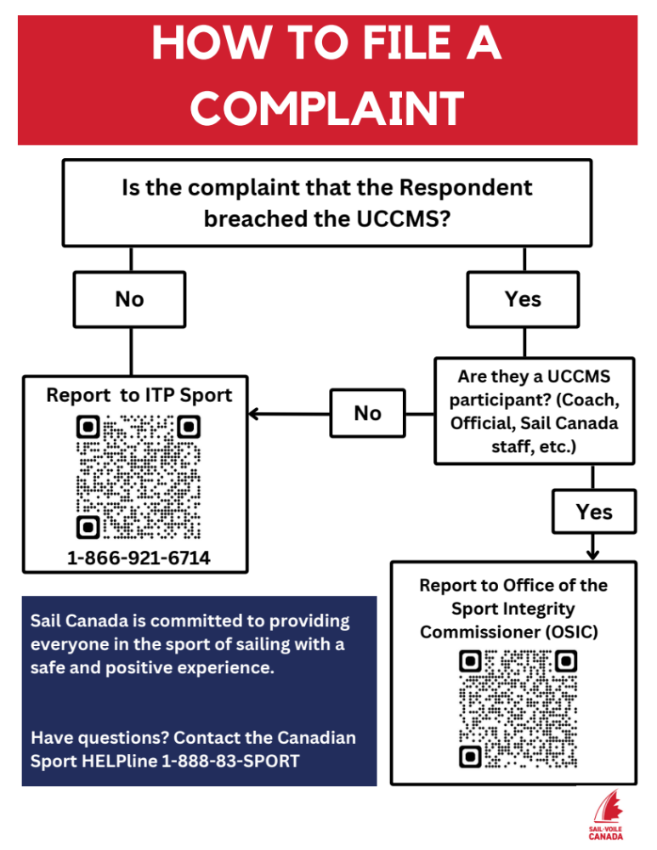
Independent Third Party
OSIC OR ITP SPORT
will triage the complaint, and determines who will manage it
UNSURE?
Abuse-Free Sport - OSIC
Canadian Sport Helpline
Our ITP – ITP Sport
Notes:
ITP information will be posted in areas in the boathouse that allows members to copy information confidentially.
ITP information also available on website.
This process is important to know and respect – respect individual confidentiality.

Slide 21
Also Note
Confidentiality
Is important to the organization and everyone involved. Please do your part!
Information obtained will be kept confidential unless disclosure is necessary to protect workers, to investigate the complaint or incident, to take corrective action or otherwise as required by law.
Privacy Policy
The policies refer to our Privacy Policy due to nature of information and confidentiality, it is essential we all keep everyone’s private and personal information safe.

Slide 22

Any Questions on Topics Covered
Full policies, How to File and more are available on our website

Slide 23
Not Just Policies
Everyone associated with the club has a responsibility to contribute to a positive environment.
Each person’s individual behaviour and communications sets the tone for the overall environment.
Preventative, Protective and Proactive
A Commitment From Each of Us

Slide 24


