Slide 1
Safe Sport
Club Orientation Slides

Slide 2
WHAT IS SAFE SPORT?
A commitment and initiative to prevent and address maltreatment in sport, ensuring sport environments are free from abuse and harassment.
HOW CAN OUR CLUB SUPPORT SAFE SPORT?
Commit to the National Safe Sport program
Build awareness amongst all club members
Create an inclusive and safe culture within our organization

Slide 3
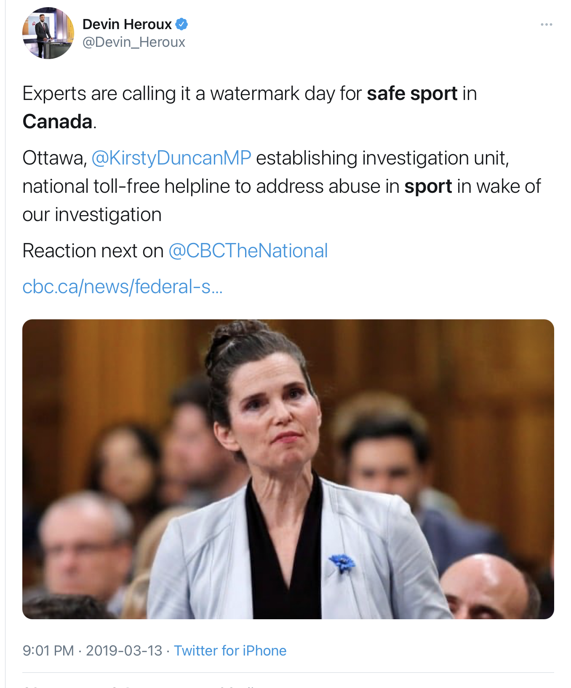
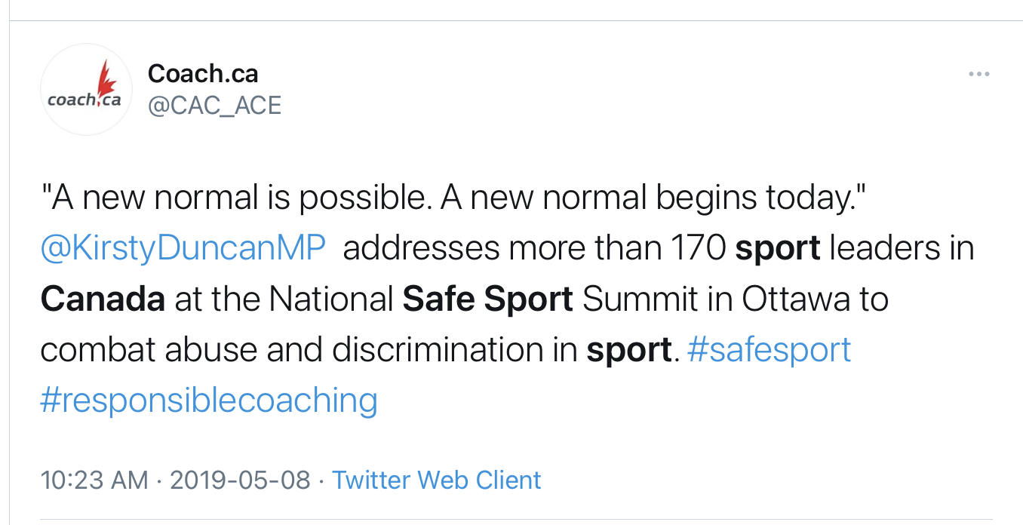
THE RISE OF SAFE SPORT
CBC Investigation (Feb 2019)
Over 20 years - 340 Coaches Charged with Sexual Offences against Minors
600 Victims, 222 Convictions, 34 ongoing cases
Spanned 36 sports

Slide 4
PURPOSE OF THESE POLICIES
To create
consistent expectations and implement a nationally aligned support system to respond to situations

Slide 5
THE POLICY PACKAGE INCLUDES:
FOUR PREVENTION POLICIES:
Code of Conduct & Ethics
Athlete Protection Policy
Social Media Policy
Screening Policy
TWO RESPONSE POLICIES:
Harassment, Discipline & Complaints Policy
Appeal Policy
Purpose:
Consistent Expectations &
Consistent Responses

Slide 6
Code of Conduct
Provides the expectation of appropriate behaviour at all times for everyone and a commitment to follow all policies in place
Everyone
Maintain and enhance the dignity of others
Refrain from harassment, maltreatment, neglect
Abide by all laws
Adults cannot consume cannabis
Alcohol can only be consumed by adults
Volunteers & Coaches
Be loyal, honest, respectful
Create a safe environment that allows athletes to meet their goals
Recognize Athletes as a whole person
Recognize the power imbalance between you and an athlete, and act accordingly
Notes:
Key expectation takeaways included on screen.

Slide 7
Social Media Policy
What is acceptable behaviour under the Code of Conduct and Athlete Protection Policy also applies to social media use
Always keep others information private
Individuals always have the right to ask rowing organizations to disengage with them on social media
Remember:
Anything you post could be seen by anyone.
Deleting media afterwards does not remove the possibility of sanctions.
What you post represents you and the sport.
Notes:
Falling short of the standard of behaviour required by the Social Media Policy and the Code of Conduct and Ethics may be subject to the disciplinary sanctions identified in the Harassment, Discipline, and Complaints Policy.

Slide 8
Athlete Protection Policy
Provides what is an acceptable safe sport environment and associated safe sport actions between coaches and athletes
The policy should be applied during:
Practices and Events
Communications
Virtual Settings
Travel
Locker Room/Changing Area
Photography/video
Physical Contact
Notes:
Athlete Protection Policy applies to coaches and athletes.

Slide 9
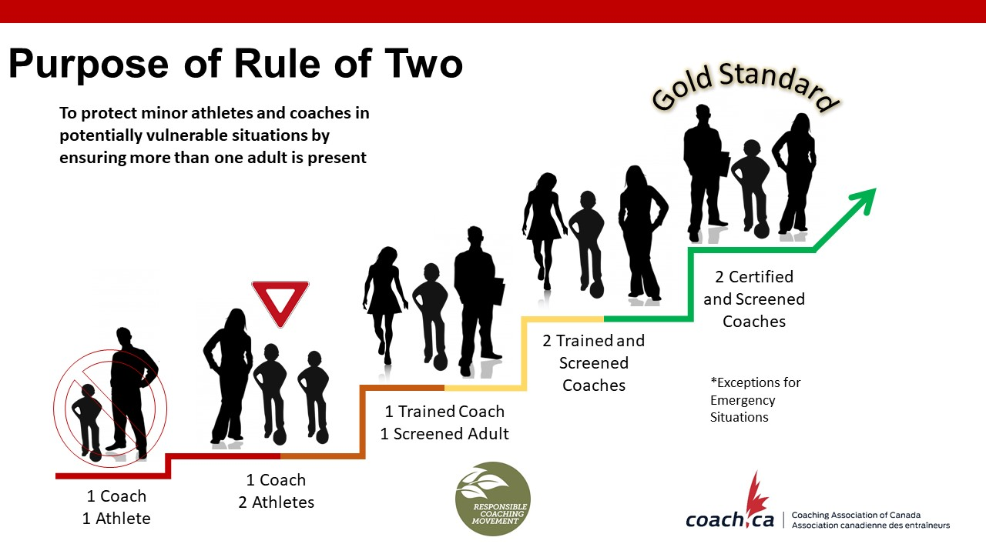
A Person in Authority should never be alone
with an athlete

Slide 10
How do we make Rule of Two work?
For example: Before & After Practice
Pickup and drop off should be timed with practice start and end times.
What does Open & Observable look like?
For example: Athlete meetings or 1 on 1 Coaching
Outside, visible and within earshot distance of another coach, screened volunteer, parent, or adult.
Notes:
Adherence to the Rule of Two is strongly recommended in any situation that involves athlete/coach interaction, and must be implemented with practical considerations in mind. This includes athlete meetings, coaching on and off the water, in electronic communication, etc. Minimum requirements are set out in Section 3 of the Athlete Protection Policy if full adherence can’t be achieved.
Medical emergencies are an exception to the Rule of Two.

Slide 11
Screening Policy
Outlines the expectations around Clubs or Special Associations to screen personnel and volunteers
Club leaders will complete some level of screening
Screening is not limited to just criminal record checks!
  Resumes/applications, interviews, references, training, etc.
Different screening requirements for individuals will depend on the risk associated with their role
  The screening matrix determines what is required
Notes:
Screenings are not just limited to criminal record checks! Screening should include resumes/applications, interviews, references, and training where appropriate.
There is a Screening Disclosure Form template available [in the COAST library]; your club’s Safe Sport Lead should have a copy.

Slide 12
Harassment, Discipline & Complaints
The main policy to deal with breaches of preventative policies
Independent 3rd Party
National
Provincial
Local Orgs
Minor issues dealt at level they occur (Complaint Resolution Officer)
NEW
Appeals of minor issues (after a request for reconsideration process) go up to Independent Third Party (ITP) for support
More serious issues get triaged to the provincial/national sport organization (NSO/PSO) for support
Notes:
Minor complaints are dealt with at the level that they occur.
New: a systematic ladder to complaint management, including an Appeal process.
More serious complaints are reported to RCA’s Independent Third Party (ITP), who determines when a Reported complaint is handled by either the Club’s Complaint Resolution Officer (CRO) or by the affiliated Provincial Rowing Association.
The role of the Independent Third Party is to triage complaints for validity & to determine who’s responsible for managing it
provides support from PSO/NSO

Slide 13

Individuals have fourteen (14) days to report a complaint in writing to the ITP
ITP triages the complaint, and determines who will manage it
Your club’s CRO will walk you through the process of resolving the complaint
Notes:
ITP information will be posted in areas in the boathouse that allows members to copy information confidentially.
ITP information also available on RCA’s website.
This process is important to know and respect – respect individual confidentiality.

Slide 14
Appeal Policy
The process to appeal decisions related to policies.
Provides individuals with a fair, affordable, and expedient appeal process for those who have been affected by a decision taken by your club that concerns:
  A conflict of interest
  Disciplinary decisions made pursuant to your club’s or (when applicable) Row Ontario’s relevant and applicable policies
  Membership

Slide 15
Questions?
Everyone has a role to play in making our club
a Safe Sport environment.
Thank you for your attention and commitment!

