Slide 1




CONCUSSIONS
Your Club Logo Here
With Resources From:

Slide 2

WHAT IS A CONCUSSION?
A concussion is a brain injury that can’t be seen on X-rays, CT or MRI scans.
It affects the way an athlete thinks, and can cause a variety of symptoms.
No two concussions are exactly alike

Slide 3
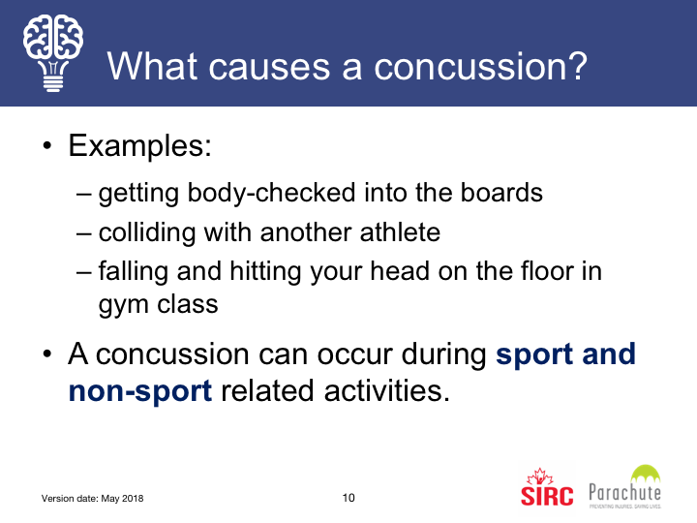
Getting hit in the head, neck or upper body with an oar or on the rigging
Falling and hitting head on slippery dock
Hitting head while loading shells /equipment on trailer or racks

Slide 4
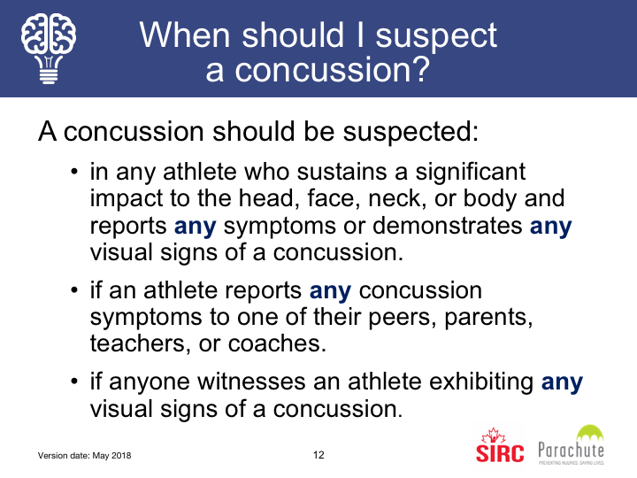

Slide 5
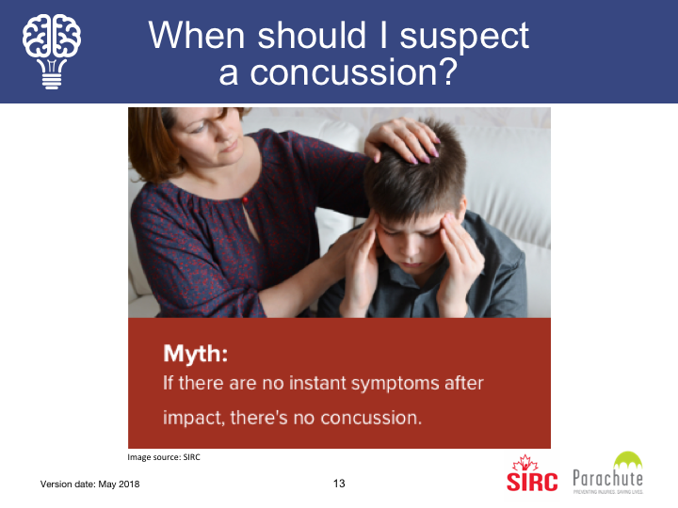

Slide 6
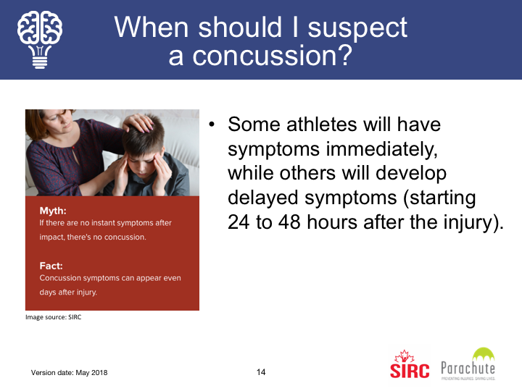

Slide 7
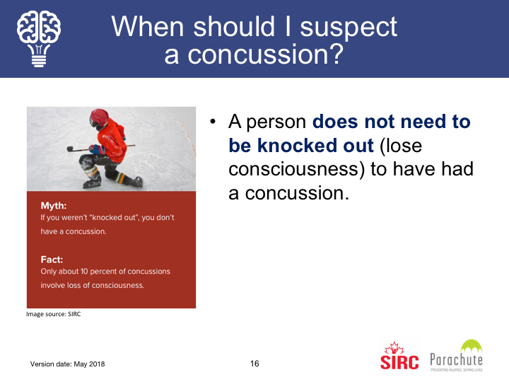

Slide 8
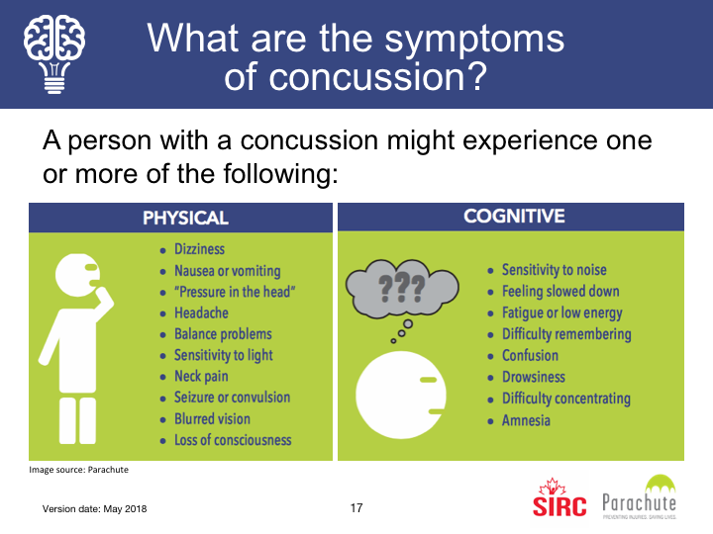

Slide 9
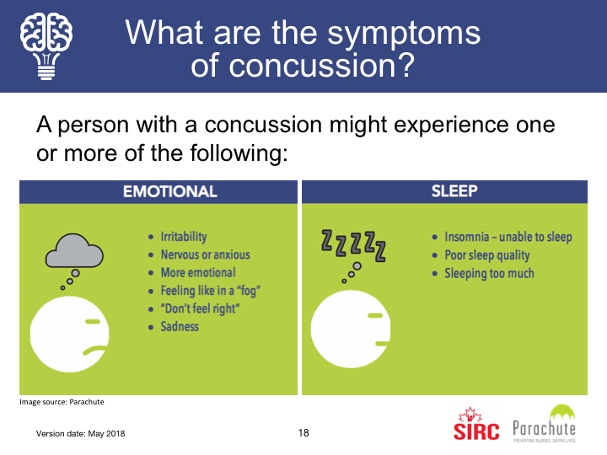

Slide 10
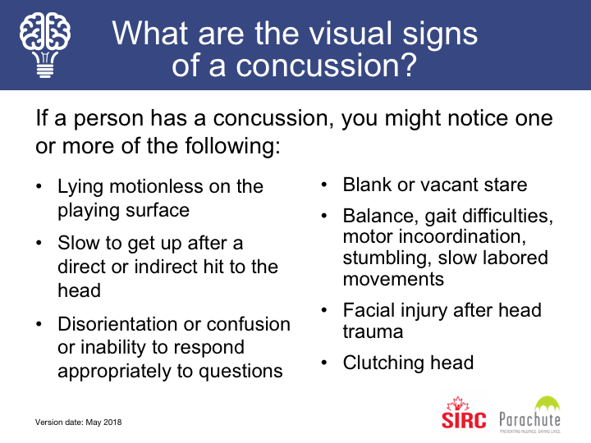

Slide 11
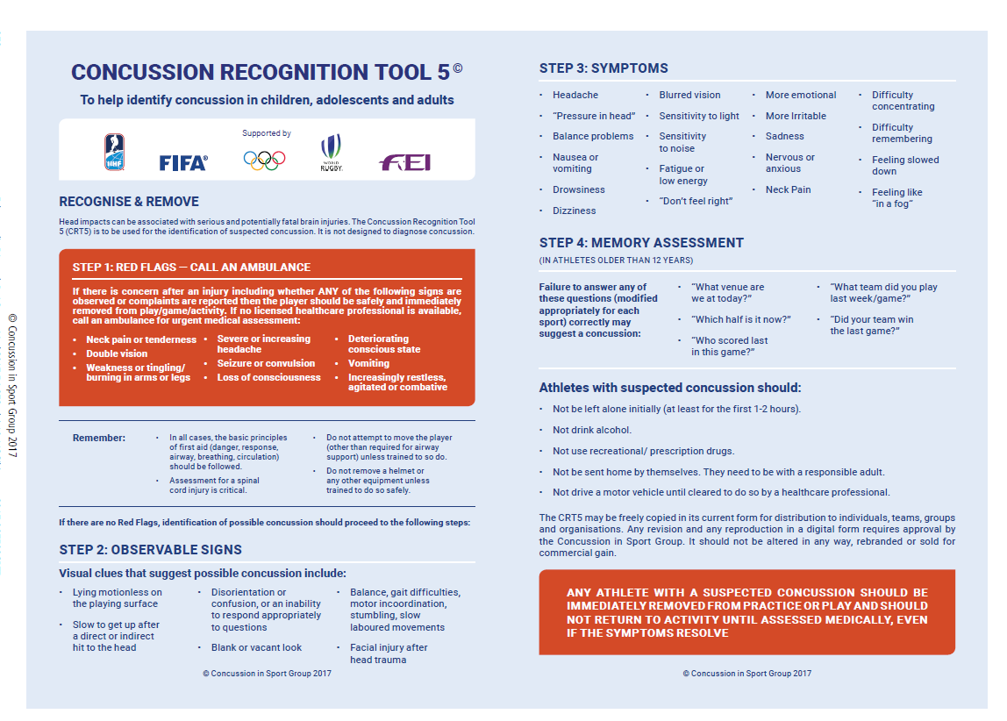

Slide 12
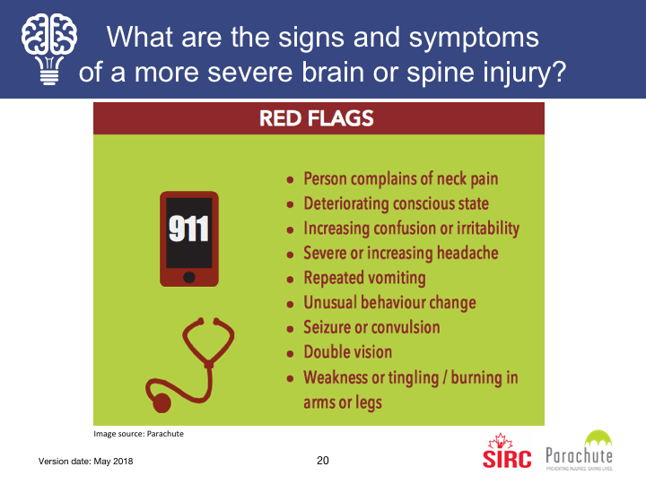

Slide 13
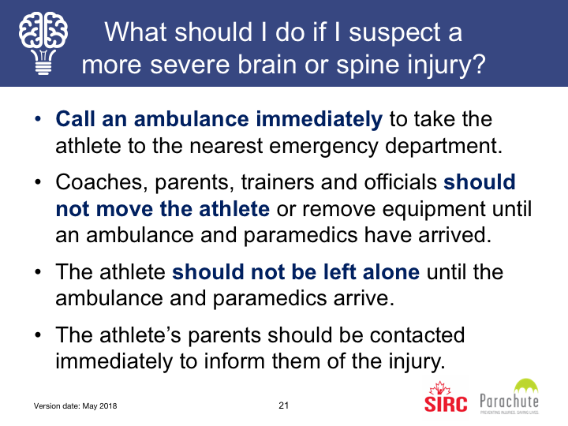

Slide 14
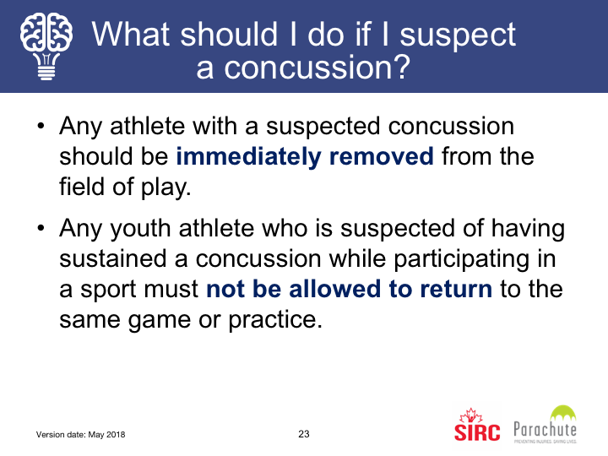
without written medical clearance – either that there is no concussion or that the concussion has healed.

Slide 15
REMOVAL FROM SPORT PROTOCOL
Programs & Practices
Means
getting them off the water
If any individual suffers any kind of injury where there has been direct or indirect force to the head, neck, face or body, AND
is demonstrating or experiencing any concussion related signs or symptoms, the individual will be removed from activity immediately by their coach.
Coach is identified as the
“Most Responsible Person” to make the decision
to Remove from Sport

Slide 16
REMOVAL FROM SPORT PROTOCOL
Procedure for immediate removal for anyone suspected of having a concussion.
The Coach/Instructor is responsible to:
Remove individual
Inform parent (if under 18)
Complete Incident Report and let PERSON X AT YOUR CLUB know
Ensures individual does not return to sport without following return to sport protocol.
Only Medical Doctors & Nurse Practitioners can diagnosis a concussion.
As a coach/Instructor you are looking for signs and symptoms that may indicate they should be assessed for a concussion.

Slide 17

REMOVAL FROM SPORT PROTOCOL
Competition
IF ANYONE SEES ANYTHING,
THEY NEED TO SAY SOMETHING
Regattas - Inform Coach, Inform Host Organization
Club Events – Inform Race Organizer or XXXX
If coach is there, they are responsible to:
Remove Individual
Inform parent if under 18
Information Club and the Host Organization – Incident Report completed
Follow up including Return to Sport Protocol

Slide 18

IF SOMEONE HAS BEEN REMOVED
They will go to a Doctor or Nurse Practitioner to be assessed
They need to get a medical assessment in writing
saying they either have a concussion or do not have a concussion and if not that they are medically cleared to participate fully.
They cannot return without something in writing from Doctor/Nurse Practitioner.

Slide 19
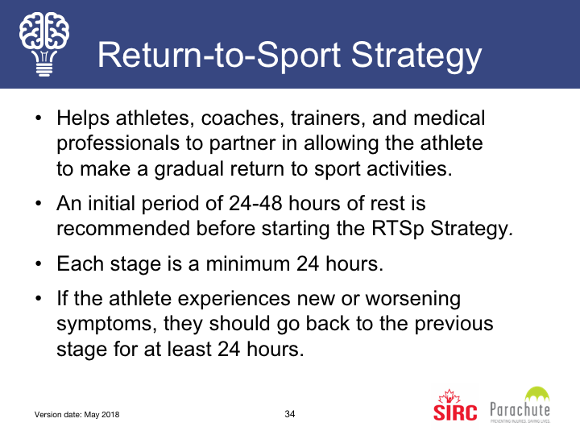

Slide 20
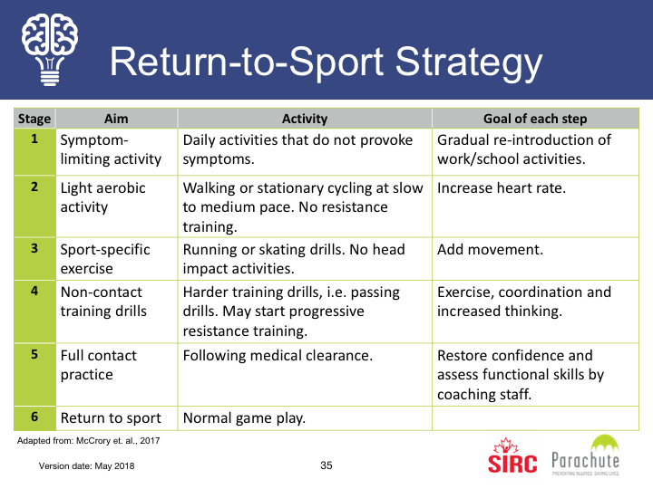

Slide 21
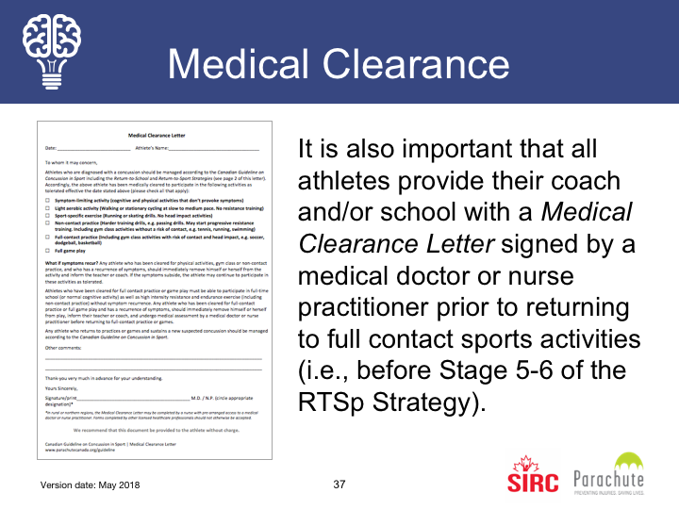

Slide 22
RETURN TO SPORT PROTOCOL – ROWONTARIO
STAGE 1: Symptom limited activity – Goal: A gradual reintroduction of activity
After an initial short period of rest of 24-48 hours, light cognitive and physical activity can be initiated as long as they don’t worsen symptoms. A physician, preferably one with experience managing concussions, should be consulted before beginning the staged process to return.
STAGE 2: Light aerobic exercise – Goal: Increased heart rate
Activities such as walking or stationary cycling. The athlete should be supervised by someone who can help monitor for symptoms and signs. No resistance training or weight lifting. The duration and intensity of the aerobic exercise can be gradually increased over time if no symptoms or signs return during the exercise or the next day.
STAGE 3: Sport specific activities – Goal: Add movement
Activities such as light running or gentle body weight resistance exercises can begin at stage 3. There should be no body contact or other jarring motions such as high speed stops or hitting a baseball with a bat.
STAGE 4: Begin Drills without body contact – Goal: Exercise, coordination, and increased thinking
Activities such as indoor rowing and resistance training can be added to activities from previous stages.
No symptoms? The time needed to progress will vary with the severity of the concussion and with the athlete. Proceed to Stage 5 only after medical clearance.
STAGE 5: On water practice, once cleared by a doctor – Goal: Restore confidence and assess functional skills by coaching staff
Coaches and instructors will allow return to the water in gradually challenging conditions.
No symptoms? Proceed to Stage 6 after minimum of two on water situations without symptoms.
STAGE 6: Competition
Return to sport with normal activities
MEDICAL CLEARANCE = ON THE WATER

Slide 23
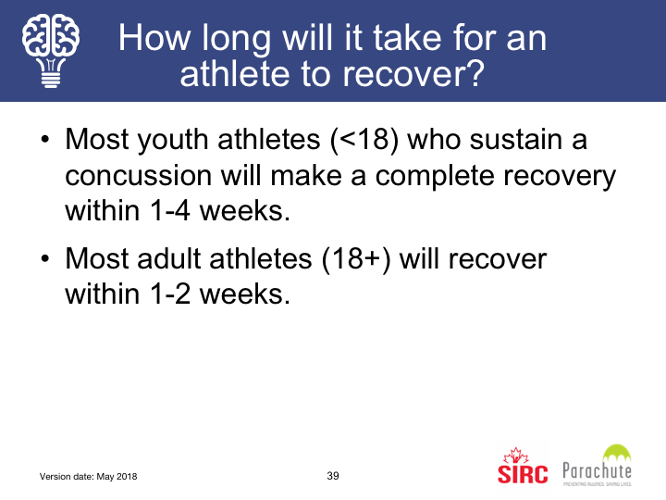

Slide 24
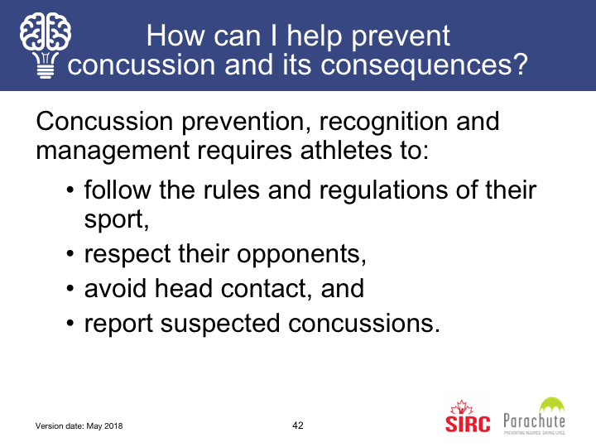

Slide 25
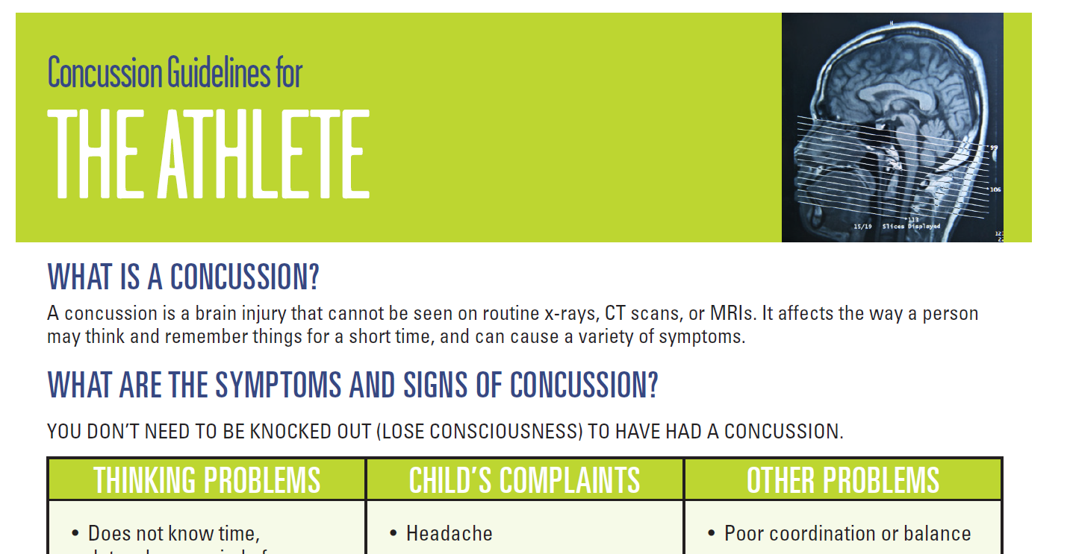
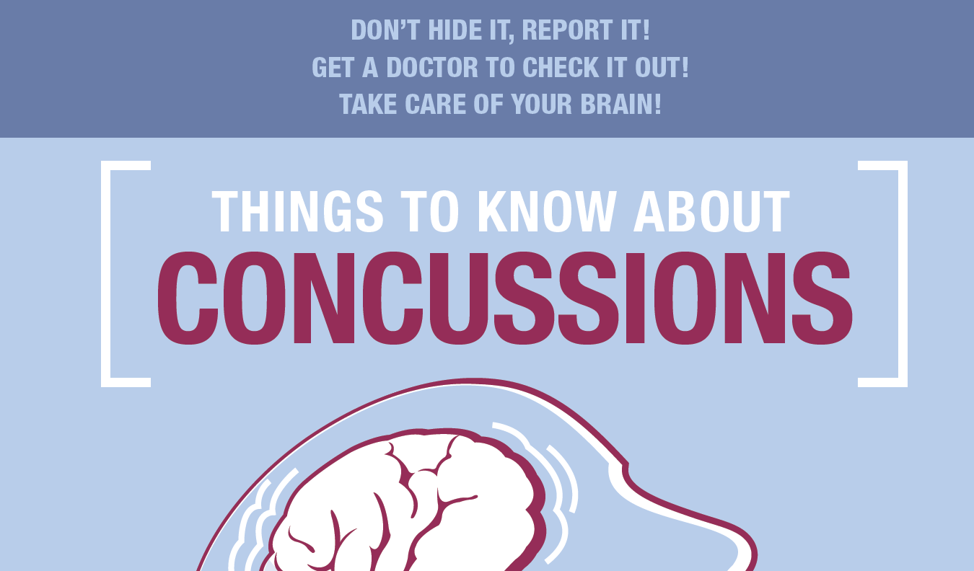
EDUCATION & PREVENTION
Annual training for Coaches/Instructors & other club leaders – education resources, signs and symptoms, procedures
Education Resources available online and in hand out format when appropriate for all participants
Coaches to educate on how to avoid concussions and awareness of situations or potential situations.

Slide 26
CONCUSSION CODE OF CONDUCT
Participants (and if under 18, their parent/guardian) have to confirm they have reviewed the Concussion Code of Conduct.
Athlete key piece is disclosure of concussion elsewhere and/or experiencing concussion symptoms
Coaches need to provide confirmation that they have reviewed organization’s Concussion Code of Conduct and understand the policy and procedures.
This will be done annually.
This Code of Conduct is in addition to the Code of Conduct under RCA as this is provincial law, however your RCA Code includes looking after safety of yourself and others.

Slide 27

How can I learn more about concussions?
www.parachutecanada.org/concussion
www.sirc.ca/concussion
www.cattonline.com
https://coach.ca/making-head-way-concussion-elearning-series-p153487

Slide 28
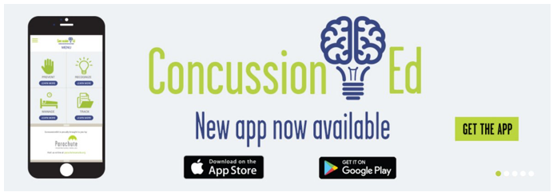
How can I learn more about concussions?
Download Parachute’s free Concussion Ed App: www.parachutecanada.org/concussion/whattodo

Slide 29
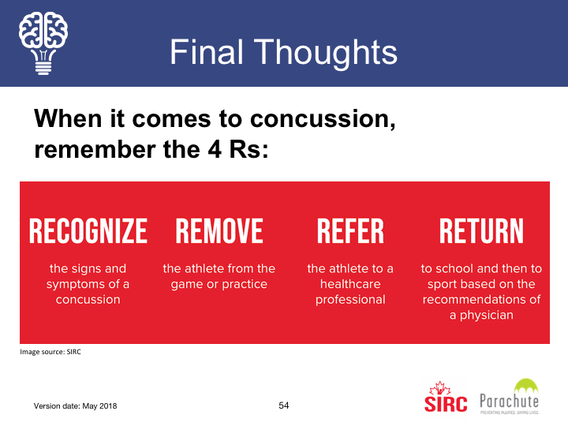

Slide 30
Questions?
Thank you

