Slide 1
Instructions on how to make your poster
Find the one below that best fits your needs – Rowing or Sailing
Insert your club name where indicated and replace the COAST logo with your club logo. (If your community name isn’t obvious in the club name and club has low visibility consider changing invites you to invites city name
Edit the date and time to fit your club
Copy that slide only into a new blank power point
Save the new document as a PowerPoint and then you can also save as a pdf and a jpeg for printing
REMEMBER
These are just samples intended to help you – feel free to play with them to add your own pictures.
JUST KEEP IT SIMPLE!

Slide 2
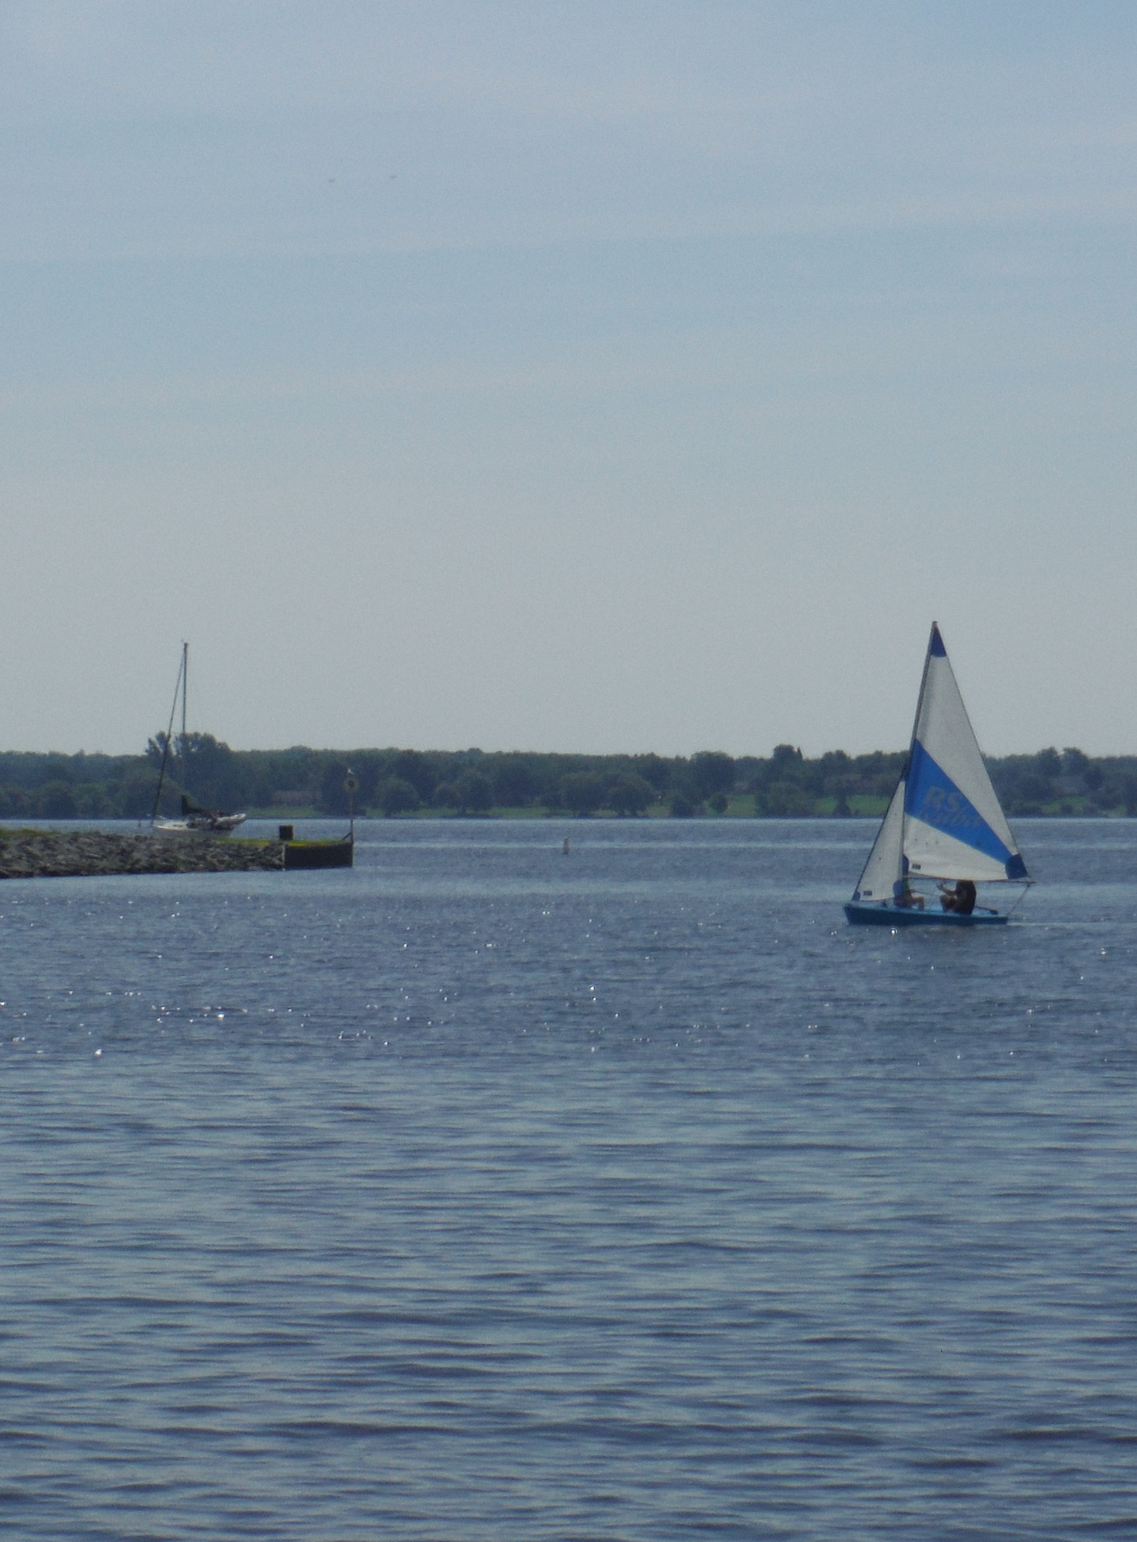

CLUB NAME
Invites You to
Try Sailing for FREE
OPEN HOUSE
JUNE 24th
10:00-12:00
Register at:

Slide 3
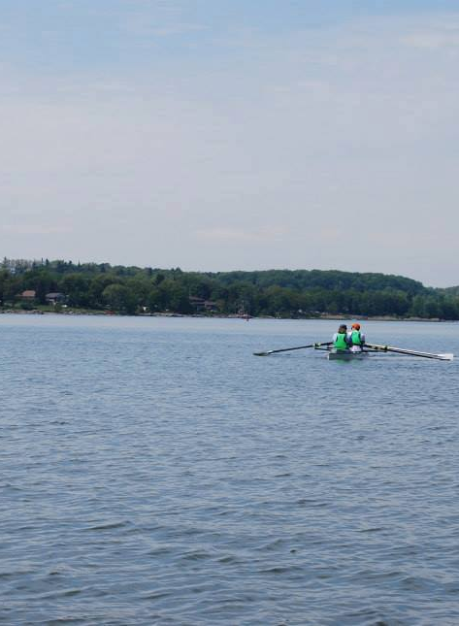
CLUB NAME
Invites You to
Try Rowing for FREE
OPEN HOUSE
JUNE 24th
10:00-12:00
Register at:

Slide 4
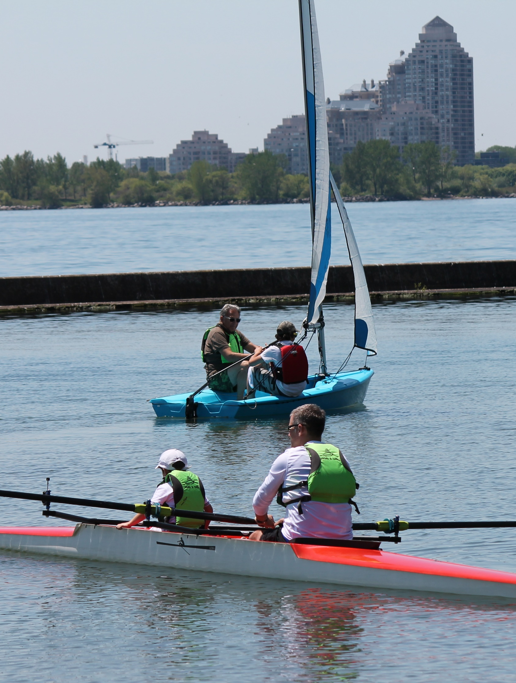
CLUB NAME
Invites You to
Try Sailing & Rowing for FREE
OPEN HOUSE
JUNE 24th
10:00-12:00
Register at:

