Slide 1
Instructions
General Promotion Images
Pick the image (s) that best reflects your club - good to use different pictures on Social Media to keep it looking new– on the one slide add your own picture
Insert your club logo into the space where the COAST logo is
Insert your club name and address where it says
If you are not using the provincial wide date – put in your date and time
Insert the website address – either the club or the registration one
Insert your contact information
Sponsors – insert a picture to add sponsor logo’s; if you had low numbers adjust paragraph to avoid number
Countdown Images
Insert your club logo into the space where the COAST logo is
To Save slides as an Image
Under File (top left) click on Save As
Browse for the folder you want to save it in
Enter an appropriate and memorable name (this name could be seen by others)
Under the file name there is a Save As Type box – click on it to save it as a JPEG File
It will give you the option to just save the current slide as a picture – do that it is easier to manage one image at a time especially as not all will apply to your club

Slide 2



FREE
We are opening our doors for you
Come find out what sailing/rowing out on the water is really like with experienced volunteers
JOIN US
Saturday June 24th 2017
9:00 am to 2:00pm
REGISTER
Our Club Name
Our Club Address
Club Website or event registration website
For More Information: Our contact Email
Contact Phone #

Slide 3

OPEN
HOUSE
Add Picture of your club or rowing in general
Come find out what Sailing is really like
Saturday June 24th 2017
9:00 am to 2:00pm
REGISTER
Club Website or event registration website
Our Club Name
Our Club Address
For More Information: Our contact Email Contact Phone #

Slide 4
Thank you to all our sponsors!
With the help of these incredibly generous community organizations we introduced sailing to over XX people

Slide 5

DAYS TO GO
Sign Up Today!

Slide 6
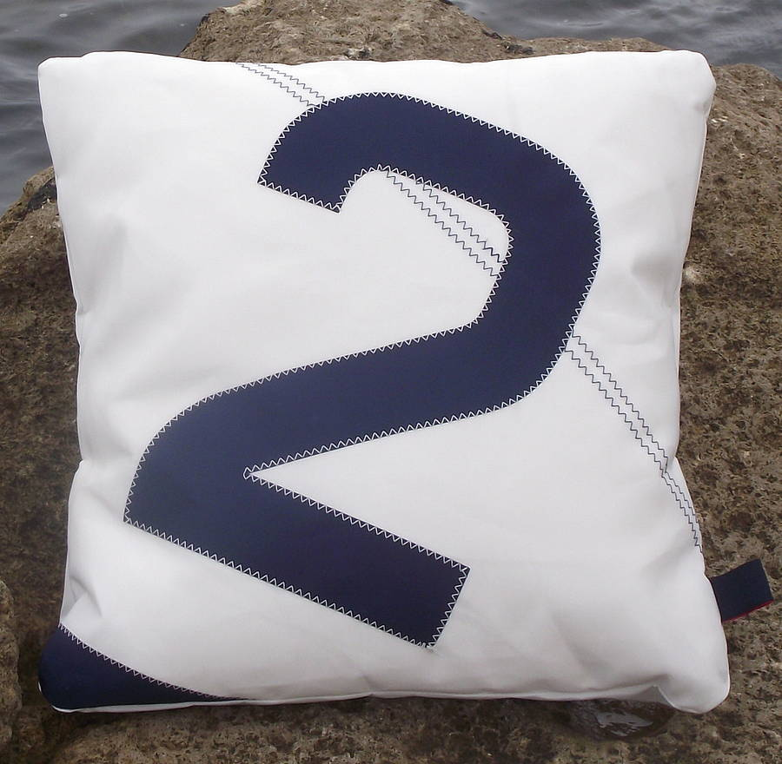
Sign Up Today!
DAYS LEFT

