Slide 1
RECOGNIZING your volunteers
Shells & Sails Administrative Webinar Series
Notes:
For the purpose of this presentation, VOLUNTEER will refer to staff, members, coaches, etc. with the purpose of recognizing all the efforts of individuals that form your club/organization.

Slide 2

Volunteering
Volunteering can produce a feeling of self-worth and respect as well as encourage skill development, socialization, and fun.

Slide 3
2013 Volunteer Recognition Study – Volunteer Canada
“almost 60% of respondents indicated that they were recruited by directly contacting an organization they were interested in…they were proactive in their search…”
Notes:
Case in point for recognition – not recruitment
Recruit, Recognize, Retain – while each category is so important, recognition is often misguided, or not done at all contributes to volunteer retention.

Slide 4
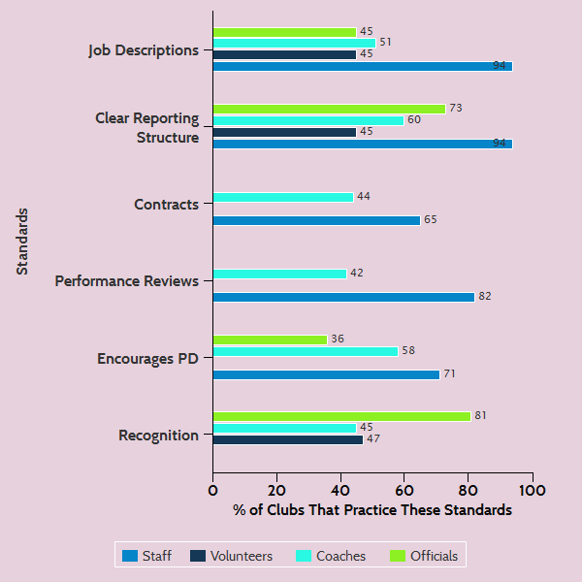
Notes:
Shells & Sails COAST Data Collected

Slide 5

Group Discussion
Please give an example of a recognition practice delivered by your club/organization.
Was there a positive outcome?
Was there any challenges?
Notes:
More and more businesses are employing Employee Engagement Officers, etc.
Volunteer recognition is more than saying thank you. It's the deliberate and intentional ongoing way that we engage with our volunteers to reinforce that they are a valuable part of our organization, that they matter and that what they are doing has an impact.

Slide 6
2013 Volunteer Recognition Study – Volunteer Canada
Most Preferred Recognition Techniques:
Hearing about how their work has made a difference
Ongoing informal personal thanks (must be sincere)
Informal group outings (picnics, potlucks, etc.)
(Younger people liked more concrete recognition – certificates, reference letters, small gifts, rewards)
Least Preferred Recognition Techniques:
Banquets
Formal gatherings
Public acknowledgment in newspapers, radio or television.
Perceived barriers by organizations: $$

Slide 7
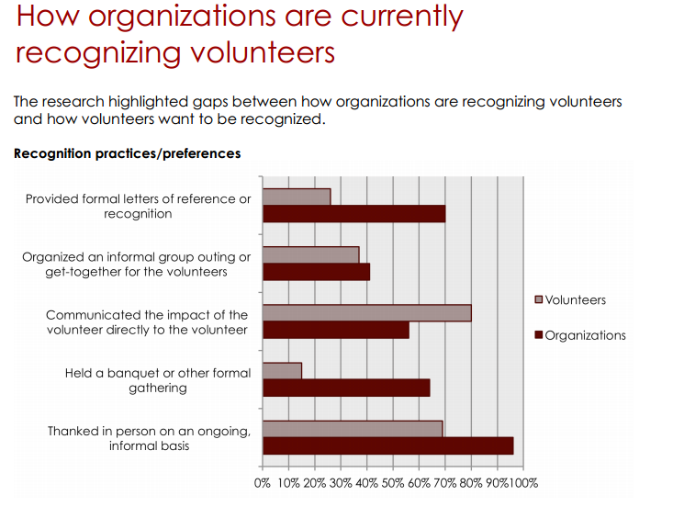

Slide 8
Volunteer Canada Cont.
Best Practices
Redefine/create the Volunteer Recognition Program – move away from single events to ongoing holistic approaches
Learn about volunteer motivations and preferences (keep referencing this feedback)
Review/check in – are volunteers meeting their desires and using/developing their skills?
Customize and deliver recognition for different individuals
Create a meaningful opportunity/event for volunteers to train/develop/network as a form of recognition
Make sure everyone is feeling welcome and appreciated!

Slide 9
Informal Strategies:
A personal note of thanks, either after an event or periodically
Sending a picture of the volunteer at the event or activity as a keepsake
Inviting the volunteers to a staff meeting to talk about the success of the event
Sending or giving cards for many occasions; remembering a special personal event
Providing an area where the volunteers can relax
Creating a wall of fame
Saying thank you, offering on the job praise
Setting aside time to evaluate their performance
Writing an article in a newsletter, website, journal or local publication
Giving opportunities for learning by providing workshops and educational opportunities
Volunteer Coffee Break (buy one cup of coffee coupons)

Slide 10
Formal Strategies:
Awarding certificates and plaques - PREB
Distributing formal evaluation and feedback surveys
Providing a timely orientation, training, supervision
Annual Event
Reference Letters
Providing meaningful work that reflects personal goals
Nominations for local, provincial and national volunteer awards
Highlighting accomplishments at the annual AGM or board meeting
Acknowledging volunteers throughout the year in a variety of ways at public events and through organizational and donor communications

Slide 11
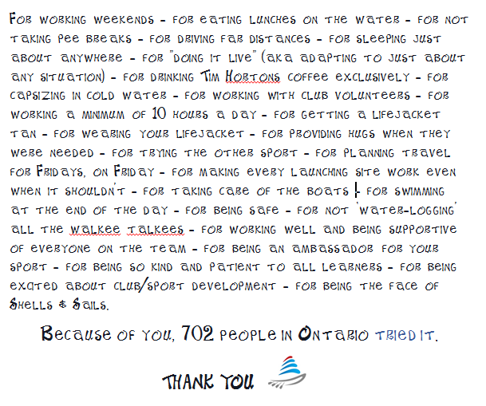

Slide 12
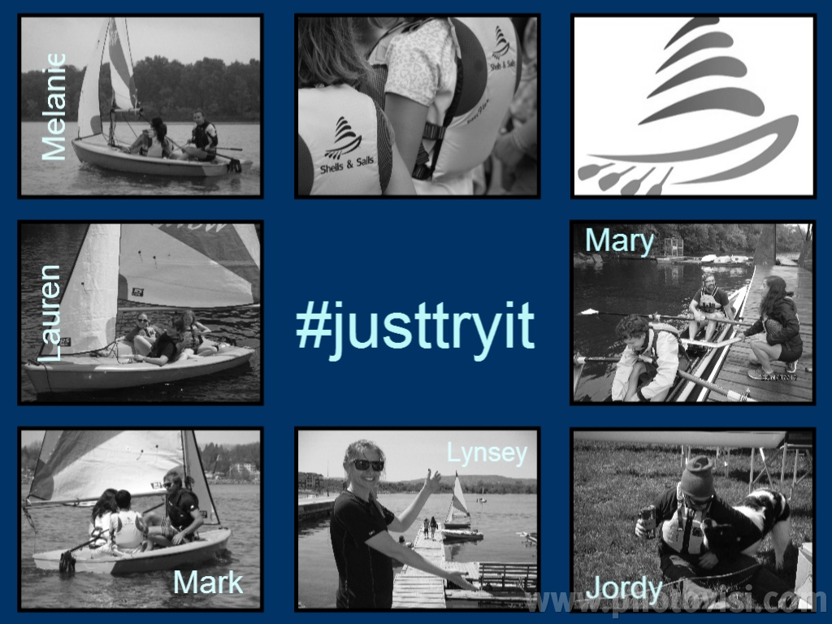

Slide 13
COAST Recommendations
Clear job descriptions
Volunteer Coordinator position on staff/board
Clear reporting structure
Clear policy/procedure documents
Conduct volunteer orientation sessions
Provide a standardized piece of clothing
Offer training/development opportunities
Recruit from youth athletes & parents
Provide a stipend or expense reimbursement

Slide 14

Engaging the People!
Notes:
https://www.youtube.com/watch?v=DiFl7XGe6IA

Slide 15
Extra Links
Top ten tips for volunteer management and retention – Link
Language of Recognition Tool – Link
101 Recognition Tips - Link
Notes:
Lynsey’s Language of Recognition Test Results:
Your Language of Recognition Results
HEARTFELT HOORAY
You prefer a personalized thank you for your volunteer efforts. It is important for you to hear about how your volunteering has impacted others.

Slide 16
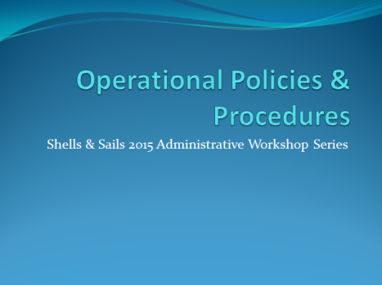

Presentation Archive
Want to refer back to this presentation? Visit the resource library at www.shellsandsails.ca!
(Password s&s1113)
Follow up questions/comments?
Lynsey@shellsandsails.ca

