Slide 1




Insurance Webinar
Presented by
Skippers’ Plan™ - The CG&B Group

Slide 2

The CG&B Group
Operated by Arthur J. Gallagher Canada Limited
Len Notaro – Senior Vice President
  Marine Insurance & Marine Liability
Andrew Robertson – Vice President
  Pleasure craft marine
Joe Marra – Senior Account Executive
  Marine Insurance
CG&B is the exclusive broker for for Sail Canada’s national & international insurance programs.
Notes:
Over 75 Years of experience in marine insurance for business and boat owners

Slide 3

Webinar Agenda
Overview
Liability, Negligence & Risk
Risk assessment and management
  Safety and liability waivers
Volunteers, staff and yacht club member participation
Questions

Slide 4

Overview
We do not know the events being planned for each club and school
Advice we provide is general in nature and may not apply to all clubs
You MUST discuss coverage with your insurance broker

Slide 5
Liability
Invited Guests have a reasonable expectation that they will not be injured
The property owner (or non-owner resident) are responsible for providing a safe environment. This is known as “premises liability”
Property owner is liable for injuries and accidents that occur on the property
Yacht clubs have inherent dangers that may not be evident to visitors.
  Docks, boats, mast cranes, dry sail cranes, marine railways etc.
Notes:
When someone enters your property, they have a reasonable expectation of not getting injured. This means that you, as a property owner (or non-owner resident), are responsible for maintaining a relatively safe environment. This is known as "premises liability."

Slide 6

The ABC’s of Negligence
A Duty of care exists
There is a breach of that duty
Damage or injury arises as a result of the breach
“To avoid liability, a person must exercise the standard of care that would be expected of an ordinary, reasonable and prudent person in the same circumstances. The measure of what is reasonable depends on the facts of each case, including the likelihood of a known or foreseeable harm, the gravity of that harm, and the burden or cost which would be incurred to prevent the injury.”
– Supreme Court of Canada
Notes:
When you invite the public into a yacht club where new and unexpected risks exists there is a very high duty of care placed on the club.

Slide 7
Duty of Care
Public has no knowledge of dangers associated with yacht clubs or boats
Greater duty of care imposed on yacht club hosting a public event
Risk of Injury or damage is greater with novices
What would be expected of a reasonable and prudent person under the circumstances?

Slide 8

Risk
Uncertainty arising from the possible occurrence of given events.

Slide 9
Risk Management in 3 Steps
What could go wrong?
What will you do to prevent the harm from occurring and in response to an occurence?
How do you protect your club/organization against damage awards?

Slide 10
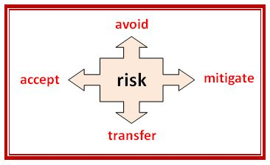
Risk Management

Slide 11
Insurance – Transferring Risk
Not all insurance policies are equal
CGL vs Marine CGL
Limits, Conditions, Exclusions
Confirm coverage for planned activities with your insurance broker**
Uninsured risks – Accept, Mitigate, Avoid

Slide 12
Volunteers & Staff
Sailing Instructors and coaches
  Sail Canada liability coverage only extends to teaching SC syllabus – not for public events
Use of private members boats
  Private pleasure use warranty
  No fees or compensation to boat owners
  Owner must be skipper of vessel
  Obtain confirmation of coverage from broker
Yacht club liability coverage for staff, volunteers and members
  Confirm coverage with your broker in writing

Slide 13
Safety Procedures – Mitigate Risk
Signage on property
Safety briefings on shore and on board
Staff and Volunteers Easily Recognizable
Safety boats
Mandatory use of PFD’s
Weather Limits
First Aid staff on site – St John’s Ambulance

Slide 14
Liability Waivers – Mitigate Risk
Weak Shield to avoid Nuisance Lawsuits
Is the waiver enforceable?
  Is the waiver valid. Did the person understand what they were signing?
  Was it explained to them in the clearest terms. Is it worded broadly to cover the activity being undertaken
  Did they have time to consider the waiver
  Were the terms unconscionable?
    Inequality arising from ignorance
    Are the terms fair, just and reasonable

Slide 15
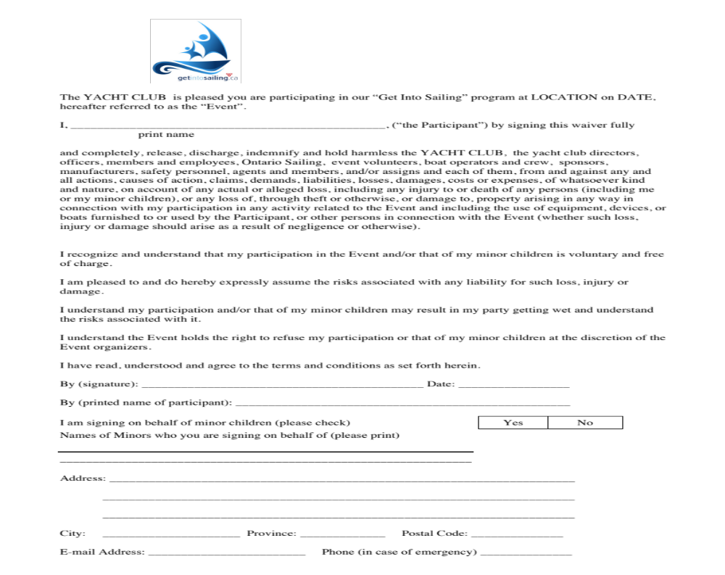
The YACHT CLUB is pleased you are participating in our “Get Into Sailing” program at LOCATION on DATE, hereafter referred to as the “Event”.
I, ________________________________________________, (“the Participant”) by signing this waiver fully print name and completely, release, discharge, indemnify and hold harmless the YACHT CLUB, the yacht club directors, officers, members and employees, Ontario Sailing, event volunteers, boat operators and crew, sponsors, manufacturers, safety personnel, agents and members, and/or assigns and each of them, from and against any and all actions, causes of action, claims, demands, liabilities, losses, damages, costs or expenses, of whatsoever kind and nature, on account of any actual or alleged loss, including any injury to or death of any persons (including me or my minor children), or any loss of, through theft or otherwise, or damage to, property arising in any way in connection with my participation in any activity related to the Event and including the use of equipment, devices, or boats furnished to or used by the Participant, or other persons in connection with the Event (whether such loss, injury or damage should arise as a result of negligence or otherwise).
I recognize and understand that my participation in the Event and/or that of my minor children is voluntary and free of charge.
I am pleased to and do hereby expressly assume the risks associated with any liability for such loss, injury or damage.
I understand my participation and/or that of my minor children may result in my party getting wet and understand the risks associated with it.
I understand the Event holds the right to refuse my participation or that of my minor children at the discretion of the Event organizers.
I have read, understood and agree to the terms and conditions as set forth herein.
By (signature): ___________________________________________ Date: _________________
By (printed name of participant): ___________________________________________________
I am signing on behalf of minor children (please check)
Yes
No
Names of Minors who you are signing on behalf of (please print)
_______________________________________________________________
Address: _______________________________________________________________________
________________________________________________________________________
________________________________________________________________________
City: _____________________ Province: _____________ Postal Code: ______________
E-mail Address: ________________________ Phone (in case of emergency) ______________

Slide 16
Avoid Risk
Host liquor Liability
Extreme weather conditions
High performance boats
Untrained volunteers
Unsupervised guests
Ad hoc events

Slide 17
Presented by Skippers’ Plan & The CG&B Group
Operated by Arthur J. Gallagher Canada Ltd.
QUESTIONS
1-800-661-7211 or Andrew.robertson@cgbgroup.com

