Slide 1

Marketing Training
By: Stephanie McKenzie
Project Manager, Ontario Sailing

Slide 2
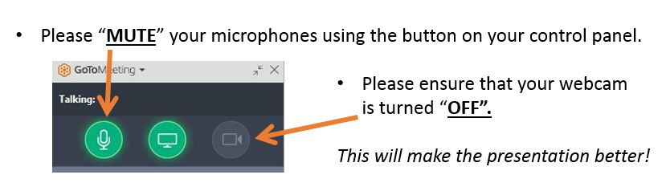

Welcome to Get Out On The Water
Stephanie@shellsandsails.ca
647-984-9506
www.getoutonthewater.ca
Facebook: /getoutonthewater
Twitter: @getonthewaters
Notes:
Strategic Plan:
By 2020, OS has committed
to create an enhanced,
Provincial wide day dedicated
to sailing
Increase awareness of our
sport
Increase participation of our
sport

Slide 3

Objective:
The objective is to promote your TRY IT day to the public
Gain more club exposure
Promote water sports
Expose the public to a fun, free, barrier free day
Promote your programs available
Notes:
Strategic Plan:
By 2020, OS has committed
to create an enhanced,
Provincial wide day dedicated
to sailing
Increase awareness of our
sport
Increase participation of our
sport

Slide 4

How to market effectively
Stay on top of commitments (newsletters, social media)
Follow up: if someone says they will help with promotion make sure to stay in contact if you have not seen your event promoted
Do not discriminate
Make time to market and follow up

Slide 5

Who you should be promoting to:
Everyone
Think out side of the box
Use your network (club members and any network you belong to professional, personal)

Slide 6

Marketing 101
Recognized Traditional Marketing
Social Media: It is free and it appeals to the masses
Print media: posters and print will be made available online
Radio Advertising: OSA has created a 25 second fully produced, radio quality commercial

Slide 7

Marketing 101 con’t
  Non traditional Marketing:
  Bloggers: Multiple in many cities
  Social Media: Still up and coming
  Local print have FREE online community events
      SNAP’D: with over 60 locations across Ontario you can post your event on the cities closest to you
      Co-op advertising: local print have discounted ad space for community events and with multiple clubs pooled together pricing can be split between any number of clubs
Notes:
Strategic Plan:
By 2020, OS has committed
to create an enhanced,
Provincial wide day dedicated
to sailing
Increase awareness of our
sport
Increase participation of our
sport

Slide 8

How to target all the demographics
Specific letters will be accessible online to send and or print
  12 and under:
  Letter to elementary schools (difficulty getting in, a letter to Principle, guidance councillor AND physical educator will make sure the right person sees event)
  Community Groups: Scouts, Big brother big sister etc (letter provided
Notes:
Strategic Plan:
By 2020, OS has committed
to create an enhanced,
Provincial wide day dedicated
to sailing
Increase awareness of our
sport
Increase participation of our
sport

Slide 9

Demographics con’t
Montesori Schools (impossible to get to as a walk in) with structured letter (accessible online) you can provide information about the day and pitch the idea of a school camp event
Momstown: All over Ontario this is a group of mothers with children who are stay at home always looking for adventures and things to keep children occupied
Notes:
Strategic Plan:
By 2020, OS has committed
to create an enhanced,
Provincial wide day dedicated
to sailing
Increase awareness of our
sport
Increase participation of our
sport

Slide 10

Demographics Con’t
Ages 13 – 18:
Highschools: same letter will be provided here you will be able to market to after school programs, school clubs, athletics department and summer schools
Online: This age lives online
Community centers: poster promotion and speak to coordinators about field trips
Notes:
Strategic Plan:
By 2020, OS has committed
to create an enhanced,
Provincial wide day dedicated
to sailing
Increase awareness of our
sport
Increase participation of our
sport

Slide 11

Demographics Con’t
Ages 19-40
GYM’S: EVERYONE IS TRYING TO GET IN SHAPE, EVEN PEOPLE IN SHAPE! Your offer extends a new way to be active and test ones limits (poster promotion is generally the only way to promote at a gym)
Post Secondary student unions: look up student union schedule a visit

Slide 12

Demographics Con’t
Other sport groups: Local Hockey organizations (Jr, minor, bantam) promotion as a team exercise in the off season. Your city has a team contact them and give them a personal invite
Online meet-up groups: a way for people to attend solo and meet people of the same mind

Slide 13

Demographics Con’t
  40+
  Local league’s: curling, bowling, hockey
  Invite director of local retirement home: Just because some one is older in age does not mean they still don’t posses the physical capabilities
  Local Condo boards: easily accessible online: locate name of buildings and access board of directors
Notes:
Strategic Plan:
By 2020, OS has committed
to create an enhanced,
Provincial wide day dedicated
to sailing
Increase awareness of our
sport
Increase participation of our
sport

Slide 14

Club Promotion
Encourage members to invite their extended family
Make sure printable posters are visible in all common areas
Promote through all club networks (social media, newsletters, word of mouth)
ASK MEMBERS TO HELP PROMOTE

Slide 15

Ontario Sailing is here to help!
Access to all posters and new commercials recorded
Access to all letters completed for school boards, community groups (These will be archived and accessible at all times)
First Contact with major marketing companies (Chrous, CITY, rogers)
Access to articles which have already been sent to major sources
First Contact with local townships and cities (Once contact has been established the appropriate forward will take place

Slide 16

Ontario Sailing is here to help!
I AM HERE, ME STEPHANIE MCKENZIE!
Do not hesitate to pick up the phone or email
I am available for web meetings, conference calls, in person. I can help promote and pitch to the appropriate people with your clubs support

Slide 17

FACEBOOK
How to create a facebook page: follow me!

Slide 18

Twitter
Generic Sign up
Tweet appropriately
Send the right information
Follow the right people
Grow your network
Make time to post

Slide 19

EVENTBRITE
ONE MORE TIME FOLLOW ME……
For pre registration: this gives you a better idea on scheduling
Ability to promote your link directly to your page
Change date, time and any other details specific to your club

Slide 20

GET OUT ON THE WATER
Any Questions?
Stephanie@getoutonthewater.ca
1-888-672-7245 ext. 225

