Slide 1




Long Term Athlete Development
Shells & Sails Administrative Webinars

Slide 2
Agenda
Introduction of the LTAD & Stages
Practical Implications of LTAD
Oakville Soccer Club Example
LTAD Implementation strategies
Resources
Next Webinar Topic

Slide 3
Sport canada
Branch of the Department of Canadian Heritage
Canadian Sport 4 Life (2005)– the movement
Long Term Athlete Development – the plan
Better Integration between all stakeholders in the sport system:
  Sport organizations;
  Education;
  Recreation;
  Health.
Key Objectives:
Winning gold medals;
Increasing participation in our sport, and
Building a sustainable organization.
Notes:
- a developmental pathway whereby athletes follow optimal training, competition, and recovery regimens from childhood through all phases of adulthood.
Since 2005, every national sport organization in Canada has developed sport-specific LTAD guidelines for their athletes.
The long term athlete development model acknowledges that physical education, school sport, recreational activities, and competitive sports are mutually dependent. Sailing & rowing are late specialization sports, and as such relies on schools, clubs and other sports to develop physical literacy and an early level of fitness. Each of these separate entities must support one another, with clearly stated roles in the developmental process. Required skills mastered after they mature. All systems must work together to encourage proper athlete and sport development.

Slide 4

Research driven stages for all levels of sport development
Recreation & High Performance & Adaptive
Program & club administration relevance
Framework & Guidelines for programming
Looks at the individual athlete development and the right stage for them

Slide 5
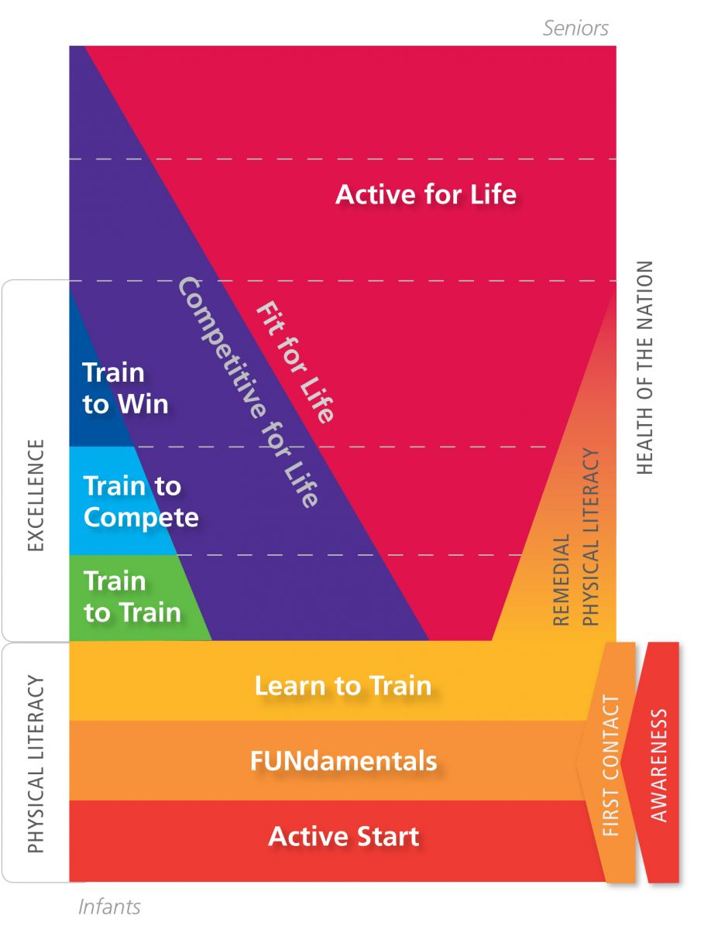
Notes:
EVERY STAGE IS IMPORTANT
Stages 1, 2 and 3 develop physical literacy before puberty so children have the basic skills to be active for life. Physical literacy also provides the foundation for those who choose to pursue elite training in one sport or activity after age 12.
Stages 4, 5 and 6 provide elite training for those who want to specialize in one sport and compete at the highest level, maximizing the physical, mental and emotional development of each athlete.
Stage 7 is about staying Active for Life through lifelong participation in competitive or recreational sport or physical activity.

Slide 6
LTAD Stages | Descriptions
Awareness | Learn about what the sport is.
First Contact | Introduction into the sport.
Active Start (0-6 years) | Physical literacy skills, unstructured play based on Agility, Balance, Coordination and Speed
FUNdamentals (girls 6-8, boys 6-9) | Fundamental movement skills, multi sports and a focus on fun with Agility, Balance, Coordination and Speed
Learn to Train (girls 8-11, boys 9-12) | Converting fundamental movement skills into fundamental sport skills. This stage is “The Golden Age of Learning” for specific sport skills.
Train to Train (girls 11-15, boys 12-16) | Athletes are consolidating their basic sport-specific skills and tactics. A major fitness development stage.
Train to Compete (girls 15-21, boys 16-23) | Competition becomes serious. Athletes have chosen to specialize and focus on one sport.
Train to Win (girls 18+, boys 19+) | Full genetic potential is realized, now training to maximize and maintain performance at the highest level. Medals and podium performances are the primary focus.
Active for Life (any age participant) | Variety of competitive and recreational opportunities
Notes:
Note that some participants may be in the same program, but at different stages in development, ready for various stages.
These are the general categories each of the typical programs fit into, but in the LTAD models, you will notice each stage has key objectives for physical development, sport specific, training, technical knowledge, equipment use, tactics, competition, lifestyle and coaching.

Slide 7
LTAD Stages | Sailing | Rowing
Awareness | Media, promotions, friends, etc. | Media, promotions, friends etc.
First Contact | Try-It Days, etc. | Try-It Days, etc.
Active Start (0-6 years) | Wet Feet | N/A
FUNdamentals (girls 6-8, boys 6-9) | CANSail 1 & 2 | N/A
Learn to Train (girls 8-11, boys 9-12) | CANSail 3 & 4 | Youth LTR, bantam, camps, novice high school programs
Train to Train (girls 11-15, boys 12-16) | CANSail 5 & 6 Chutes & Wires | 2nd year and higher high school, varsity, club junior and U23 programs
Train to Compete (girls 15-21, boys 16-23) | CANSail 5 & 6 Chutes & Wires | Henley and higher, Canada Games, NRCs, seniors, masters competition
Train to Win (girls 18+, boys 19+) | Nation Team Competition | National Team Competition
Active for Life (any age participant) | Any LTS age for recreational and fun competition | Any LTR age for recreational and fun competition
Notes:
Recommended programs

Slide 8
Practical implications for clubs
1. Strategic Planning with LTAD
  - Athletes/participants are the core business of sport organizations
  - Sustainable LTAD should be the focus
  - What does the athlete need? What must coaches do to provide it? What organizational infrastructure is necessary to support it?
  - Further guidance and clarity in the planning process.

Slide 9
Practical implications for clubs Cont.
Track program recruitment & dropouts in relation to the LTAD
Consider Partnerships that address LTAD gaps (both introductory and high performance)
Evaluate current programs based on LTAD & club priorities
LTAD as a tool for program development
Funding Opportunities – Be a reliable and committed sport organization
Notes:
Make sure your club has programs and opportunities for each LTAD stage – or at least can connect and address next steps for athletes.
Partnerships: Consider partnerships with schools, rec centres, other sports to deliver programs that build water and boat skills during Learn to Train stage.

Slide 10
Soccer Club Example
“If you genuinely want to implement CS4L, if you have the right things in place, it can be done relatively straightforwardly.” – Oakville Soccer Club ED
10 Lessons:
Make CS4L knowledge a required competency at Board level
Embed CS4L in your strategic planning
Ensure your technical leader is a genuine CS4L proponent
Embed CS4L in technical planning and coach education
Break down CS4L into easy-to-understand benefits
Communicate, communicate, communicate!
Ensure you have a strong relationship with your facilities partners
Just do it!
Talk to the kids
Measure progress and promote success
Link

Slide 11
COAST Recommendations & next steps
(Incorporating LTAD Concepts & philosophies)
Your club endorses the LTAD (Long Term Athlete Development) and CS4L (Canada Sport 4 Life) models. (35%)
Your club has a LTAD plan. (19%)
Your club ensures all Board of Directors, Staff and Coaches are educated on the LTAD and CS4L models. (13%)
Your club ensures all program development decisions are made with LTAD in mind. (21%)
Your club explains the importance of LTAD to parents and new participants. (18%)
Your club has established a clear pathway for participants to develop through the LTAD model. (21%)
Your club has an LTAD section on its website. (4%)
Notes:
Any club can do this – irrelevant of the current program capacity. This is an easy way to break down this larger change/task. Not asking you to change your programs.
Make sure to update COAST
This is where all the sectors can come together and ensure the LTAD achieves it’s three goals - Winning gold medals;
Increasing participation in our sport, and
Building a sustainable organization.

Slide 12
Resources
Rowing Canada Aviron’s LTAD – Link
Sail Canada’s LTAD – Link
Strategic Planning based on LTAD – Link
Canadian Sport for Life & LTAD Website - Link

Slide 13
Next webinar:
FUNDRAISING PRACTICES
Wednesday April 8 @ 7 PM
Presentation by fundraising professional Emily Clark

Slide 14


Presentation Archive
Want to refer back to this presentation? Visit the resource library at www.shellsandsails.ca!
(Password s&s1113)
Follow up questions/comments?
Lynsey@shellsandsails.ca

