Slide 1

Follow Up
By: Stephanie McKenzie
Project Manager, Ontario Sailing

Slide 2
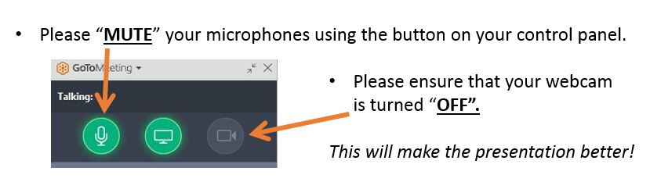

Welcome to Get Out On The Water
Stephanie@shellsandsails.ca
647-984-9506
www.getoutonthewater.ca
Facebook: /getoutonthewater
Twitter: @getonthewaters
Notes:
Strategic Plan:
By 2020, OS has committed
to create an enhanced,
Provincial wide day dedicated
to sailing
Increase awareness of our
sport
Increase participation of our
sport

Slide 3

Why:
The objective was to promote your TRY IT day to the public
Gain more club exposure
Promote water sports
Expose the public to a fun, free, barrier free day
Promote your programs available
Notes:
Strategic Plan:
By 2020, OS has committed
to create an enhanced,
Provincial wide day dedicated
to sailing
Increase awareness of our
sport
Increase participation of our
sport

Slide 4

Make Notes!
Whatever strategies you used in your marketing you want to be able to go back and see what worked and what didn’t work
Notes will help eliminate guess work
Saves time: copy and paste, use similar posters/tools/posts/newsletters etc

Slide 5

On the spot sign up
What does you club offer by means of getting involved: learn to sail, membership
Make sure there is a sign up or registration form readily available for people to sign up after they have been on the water
Suggested: Tour of facilities at a later date (invite them back more likely to come)

Slide 6
Take Homes
Club swag (key chains, future invitation to open house if planned)
Suggested: print the nautical terms located online or your own with your club contact information
Suggested: Completed certificate (will be available online)

Slide 7

Reconnecting with a newsletter:
Specific Newsletter to new and interested parties (participants in your open house)
Know the circulation schedule before you meet with people (too many emails and you will loose interest
1 page with a call to action
Do not be afraid of listing prices PEOPLE HATE GUESS WORK!!!

Slide 8

Do not lose contact!
Stay accessible
  Through a positive fist contact experience participants will be more likely to return
  Encourage them to join any social media (Facebook or Twitter) so they can stay up to date while they consider becoming a member
Notes:
Strategic Plan:
By 2020, OS has committed
to create an enhanced,
Provincial wide day dedicated
to sailing
Increase awareness of our
sport
Increase participation of our
sport

Slide 9

BRAG BRAG BRAG BRAG BRAG!
Highlight your positives
Talk about what makes you different
Zero in on their objectives (family friendly, remote, members only)
Let people see your enthusiasm for being a part of your specific club
Notes:
Strategic Plan:
By 2020, OS has committed
to create an enhanced,
Provincial wide day dedicated
to sailing
Increase awareness of our
sport
Increase participation of our
sport

Slide 10

Ontario Sailing is here to help!
I AM HERE, ME STEPHANIE MCKENZIE!
Do not hesitate to pick up the phone or email
I am available for web meetings, conference calls, in person. I can help promote and pitch to the appropriate people with your clubs support

Slide 11

GET OUT ON THE WATER
Any Questions?
Stephanie@getoutonthewater.ca
1-888-672-7245 ext. 225

