Slide 1

First Contact:
What you need to know about making that first-time experience effective.
By: Stephanie McKenzie
Project Manager: Get Out On The Water

Slide 2
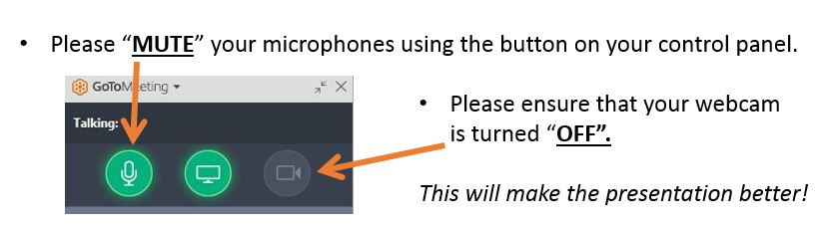

Welcome to Get Out On The Water
Stephanie@shellsandsails.ca
647-984-9506
www.getoutonthewater.ca
Facebook: /getoutonthewater
Twitter: @getonthewaters
Notes:
Strategic Plan:
By 2020, OS has committed
to create an enhanced,
Provincial wide day dedicated
to sailing
Increase awareness of our
sport
Increase participation of our
sport

Slide 3


SMILE
As the public begins to show up for the day a few suggestions
  Volunteers should be easily recognizable
  Name tags
  Introduce club volunteers
  Encourage questions
  SMILE!!!!!!!!!!!!!!!!!!!!!!!!!

Slide 4
First Contact Experience
Key things to consider before interacting with the public:
  First time on or near the water
  First time being exposed to a water sport
  First time in a club/organization environment
  First time being introduced to the idea that they can enjoy your sport as a hobby
Notes:
Strategic Plan:
By 2020, OS has committed
to create an enhanced,
Provincial wide day dedicated
to sailing
Increase awareness of our
sport
Increase participation of our
sport

Slide 5
Remember the general public may have Perceived Barriers
Sailing and rowing is too expensive to get into.
Difficulty of learning the sport.
Misconception of the nature of the sport
  Too boring, dangerous, elitist, etc.
Assumption that modifications cannot be made to accommodate the needs of everyone.

Slide 6

How to overcome Barriers
Education and Awareness.
  Which is what this program is all about!
Offer programs that accommodate a variety of needs.
  Opportunities for any budget.
  Various levels of competition and skill development.
  Accessible for EVERYONE!

Slide 7

Participants with a Disability
Awareness
  Opportunities for persons with disabilities to participate in sport and physical activity are not always well known to the general public.
First Contact
  Ensure persons with disabilities have a positive first experience and remain engaged. BY helping them to feel confident and comfortable in their surroundings and welcome to your sport they are more likely to return.

Slide 8

Introduction
Should be no more than 10 minutes long.
  Remember the goal is to get out on the water, not into a classroom!
Introduce SOME terminology
Outline that to expect on the water
Discuss safety equipment, procedures, and rules.
Remember to be energetic and excited as this will get the participants ready to have FUN!

Slide 9

On-Water Session: Speak slowly and loudly
There should be an initial demonstration of skills and safety practices.
  Teach them where to sit, what to do, and how to move during maneuvers!
LOTS of involvement and participation from the students!
  Encourage them to asks questions
The focus should be on having FUN!

Slide 10

After they Get Out On The Water
Recap learning from the on-water session.
Provide specific feedback to each of the participants.
  Make sure to highlight at least one success/achievement if this is possible
Provide information on next steps!
  What programs does the club offer?
  How can they participate more at your club?

Slide 11

Follow up and Retention
COMMUNICATION
  Establishing an open line of communication between the club and participants is essential.
MEET INDIVIDUAL NEEDS
    Failure to meet the needs of an interested individual can cause them to loose interest in a sport
    Continue to modify and offer programs to meet the needs of interested participants

Slide 12

Safety Considerations & Tips
Certified Lifejackets and PFD’s for all participants and volunteers.
  Size, condition, and properly worn.
Weather Conditions – be vigilant!
Have emergency protocol in place
Check all equipment to ensure it is in good working order.

Slide 13

First Contact
Be an Ambassador for the sport
  Provide each participant with a fun and safe first experience with sailing and rowing!

Slide 14

GET OUT ON THE WATER
Any Questions?
Stephanie@getoutonthewater.ca
1-888-672-7245 ext. 225

